Slide 1
Tools of the trade
Three tools to awesome-ify your .Net Apps

Slide 2





Who am I?
Brian Gorman
~18 or so years full stack dev experience
.Net, Java, PHP, MSSQL, MySQL, Javascript, Bootstrap, css…
Computer Science Adjunct at Franklin University
Technical trainer with courses available on Udemy
, O’Reilly, SkillShare, and a few others.
Full Time Developer at Far Reach in Cedar Falls, Iowa
Main tech stack => .Net/MSSql => Microsoft

Slide 3
Agenda
Automated Background Processes
Using Hangfire [https://www.hangfire.io/]
Centralizing, Logging, and Understanding application errors
Using Elmah [https://elmah.github.io/]
Tracing Web Requests
Using Stackify Prefix [https://stackify.com/prefix/]

Slide 4
Automated Background Jobs
Hangfire

Slide 5
Getting started
Get the NUGET package [Install-Package Hangfire]
Configure the startup with a globalization for the db connection, and add the dashboard and server to the application
Run the solution, which will generate the appropriate tables
View the dashboard
Add an enqueued job
Watch the magic happen

Slide 6
Types of Jobs
Fire-and-Forget
Runs Once Immediately
Delayed
Runs Once as scheduled
Recurring
Runs many times as scheduled
Continuation
Runs after parent job finished
Batches (Pro Only)
Runs a group of jobs as an automic unit
Batch Continuations (Pro Only)
Runs when all jobs in parent batch finished

Slide 7
Features/Benefits
Persistent in the DB (runs across app-pool restarts)
Extensible/Abstracted [job storage can be anywhere]
Efficient [can use MSMQ]
Reliable [automatically retries background jobs]
Self-maintained
Integrated monitoring dashboard
Ability to retry failed jobs
Ability to drill into completed job details

Slide 8
Easy Setup
Add code from readme into startup
Include use dashboard to show the dashboard
Dashboard requires authentication []
Build out your job service(s) [i.e. Emailer code]
Add a simple block of code to fire a background job

Slide 9
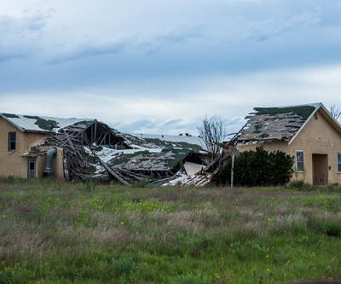
Demo Time

Slide 10
Centralizing, Logging, and Understanding application errors
Elmah

Slide 11
Getting started
Get the NUGET package
Configure the Web.Config
Create a migration for the DB (if not centralizing)
Add any roles and associate users (for viewing)
Create some Errors [if none exist]
View the errors (elmah.axd & in the DB table)
Modify the config for release with project name

Slide 12
Benefits
All logging is virtually automatic
Can be centralized to one database for multiple applications
Multiple options for reviewing errors
Detailed stack trace
Detailed page information

Slide 13

Demo Time

Slide 14
Tracing your Web Requests
Stackify Prefix

Slide 15
Getting Started
Download Prefix from Stackify
Install the HTTP Module NUGET package
Start Prefix on your machine
Enable the .net Profiler
Run your application
View and work with various tracing calls

Slide 16
What does it provide?
All of your web requests are individually tracked
Number of DB calls
Runtime of each request
Compare requests
Find errors
Identify bottlenecks
Fix bad sql utilization (n + 1, repeated calls, etc)

Slide 17
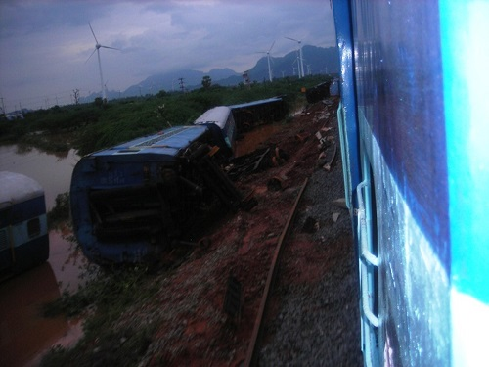
Demo Time

Slide 18
Questions?
blgorman@gmail.com
Twitter: blgorman
https://courses.majorguidancesolutions.com/p/tools-of-the-trade-talk
https://www.github.com/blgorman/ContactWeb_Advanced
https://www.linkedin.com/in/brianlgorman/

